Slide 1
Summary PRAGMA Steering Committee Meeting
11 October 2012

Slide 2
Steering Committee Issues
Building the PRAGMA Cloud
Planning Components and Integration Path
Identifying, Building, and Mapping Expeditions to Develop and Integrate Components
Developing Users and Partners
Seeking Funding for Expanding PRAGMA’s Impact
Supporting PRAGMA Student activity
Future Meetings
Membership Update

Slide 3

PRAGMA Collaborative Overview 2012 - 2013
Will be asking for input by Monday 15 October
Will want response by Monday 22 October
To be ready by SC12

Slide 4
Grass-roots International CI: Common Environment Enables Collaboration
Component
Challenge: Integration
and a Plan for Trust Envelop
VM Migration, images and clusters
Overlay network experiments
Data cloud
Observing systems
Importance Steps
Clear dialog between applications and resources
Realistic in “readiness” to use infrastructure
What is needed; where are data?
Using the Expeditions to Drive
The Development of a
TRUST ENVELOPE
Notes:
We started moving from Grid to Virtualization after pragma 17 (Vietnam – 2009)
Belief: To collaborate we want to have a common environment / an environment we can share
Provide an infrastructure that initially limits access to data
Traverse firewalls and simplify network re-configuration of application VMs

Slide 5
Student Activities
Experiences from Students
Language confidence
Network of colleagues -
Organizational Experiences
Workshops and Posters
Ideas for future
Technical seminars (webinar)
Engage more students
Keep them engaged
We need to support this activity

Slide 6
Future Workshops
PRAGMA 24
Bangkok Thailand
Kasetsart University
And others
2013 March 21 – 22
Workshops on 19 and 20
PRAGMA 25
CNIC has offered to host
Beijing
September 2013

Slide 7
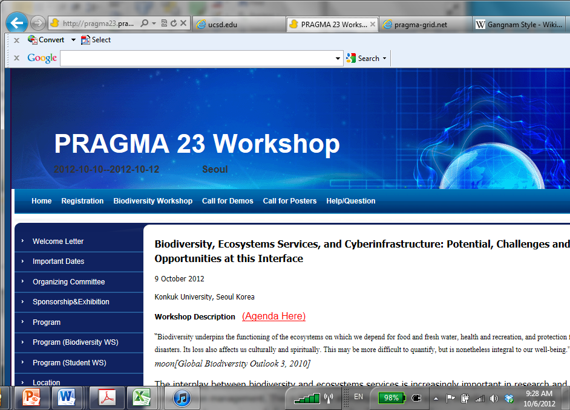

Acknowledgements
General Chairs
Karpjoo Jeong: Konkuk U
ChoonHo Kim: SUNY Korea
PRAGMA 23 Program Committee
Kevin Dong: CNIC
Reed Beaman: U Florida
Putchong Uthayopas: Kasetsat University, chair of PRAGMA 24
Seunho Jung: Konkuk U
Sang Boem Lim, Konkuk U
Namseo Koo: Konkuk U
Chon Ho Kim, Konkuk U
Young Sunwook, Konkuk U
Junghun Woo, Konkuk U
Yong Dan Eo, Konkuk U
Biodiversity Workshop Program Committee
Reed Beaman: U Florida
Eun Shik Kim: Kookmin U
Karpjoo Jeong: Konkuk U
Student Interim Steering Committee
Meelan Kang: Konkuk U
Taiki Tada: Osaka U
Uma Pavalanathan: IU
Yuan Luo: IU
Demonstrations and Technical Support Website
Kevin Dong
Poster Session Chair
Yuan Luo
Local Organizers
Eu Joon Kim
Dong Ryul Han
Hyun Shik Han
Myung Yoon Choi
Dae Joong Kim
Notes:
Local Organizers:
Eu Joon Kim
Sang Boem Lim
General Chairs
Karpjoo Jeong (Konkuk University)
ChoonHo Kim (SUNY Korea)
Student Interim Steering Committee and Posters
Meilan Jiang (Meelan Kang)
Taiki Tada
Umashanthi Pavalanathan
Yuan Luo
Demonstrations and Technical Support Website
Kevin Dong
Poster Session Chair
Yuan Luo
Members of the PRAGMA Program Committee
Kevin Dong (CNIC)
Reed Beaman (U Florida)
Putchong Uthayopas (Kasetsat University, chair of PRAGMA 24)
Seunho Jung (Konkuk University)
Namseo Koo (Konkuk University)
Members of the Biodiversity Workshop Program Committee
Reed Beaman
Eun Shik Kim
Karpjoo Jeong

Slide 8
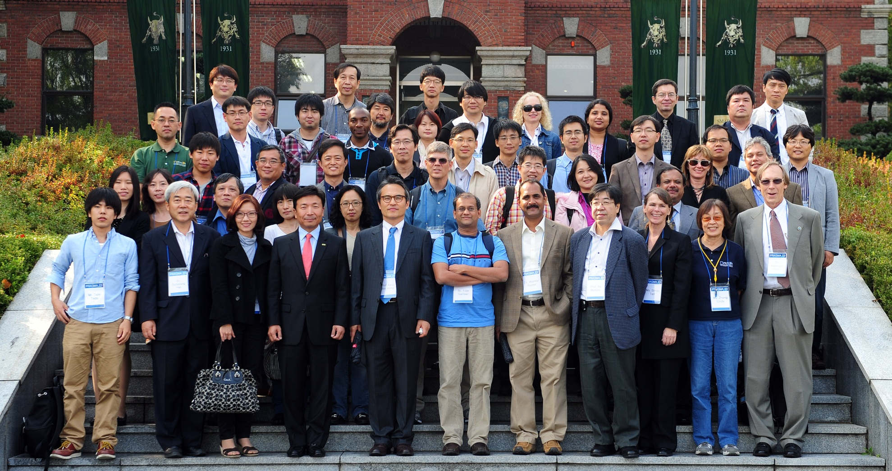
Thank You Konkuk

